Slide 1

COP 4530 Final Project Dijkstra’s Algorithm
Final Project By Dev Tejwani and Barath Dandu

Slide 2
Description
It was created by Dijkstra's algorithm
It is called the single-source shortest path
It computes length of the shortest path from the source to each of the remaining vertices in the graph.
The algorithm is considered a Greedy algorithm as they use problem solving methods based on actions to see if there is a better long-term strategy.
Works on both directed and undirected graphs. However, all edges must have nonnegative weights.

Slide 3
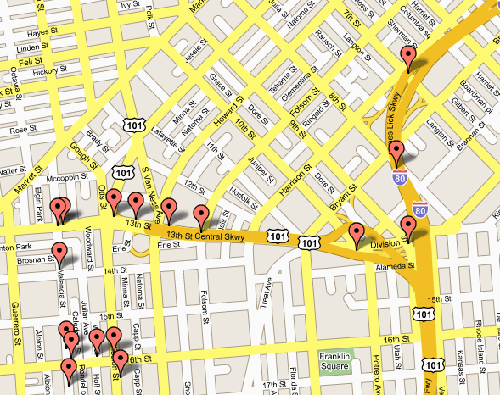
Real World Uses
- Traffic Information Systems are most prominent use
- Mapping (Map Quest, Google Maps)
- Routing Systems
Epidemiology: Researchers use networks to model the spread of infectious diseases and design prevention and response strategies.

Slide 4
HOW IT WORKS
Maintains an estimate distance of vertex of the length from its source of the shortest path for each vertex.
The algorithm will process the vertices one by one in some order. Processing a vertex means finding new path and updating distance for all vertex belonging to adjacent vertex if necessary. This process is called relaxation.
It maintains a subset of vertices, for which the true shortest distance is known.
The vertices are selected one by one to be added to source. The next selected vertex is always a vertex whose distance estimate is minimum

Slide 5
Working
Create a set called unvisited set. To every node assign distance value, zero for source node and infinity to all nodes. Mark the source node as current node. From current node calculate distance between it and its unvisited neighbors. Then compare newly calculated distance to previous distance and assign the smaller one. After visiting a node remove it from unvisited set. When the destination node has been marked visited stop as the algorithm has finished its course. Otherwise select unvisited node with the least distance and repeat the process from current node step.

Slide 6
Implementation:
The simplest implementation is to store vertices in an array. This will produce a running time of O(|V|^2 )
For graphs with very few edges and many nodes, it can be implemented more efficiently storing the graph in an adjacency list using a binary heap or priority queue. This will produce a running time of O((|E|+|V|) log |V|)

Slide 7
Functions Implemented:
It created and added a vertex to the graph with label, to make sure no two vertices have the same label.
It removes the vertex with label from the graph.
It adds an edge of value weight to the graph between the vertex with label1 and the vertex with label2.
It removes the edge from the graph between the vertex with label1 and the vertex with label2.
It calculates the shortest path between the vertex with start Label and the vertex with end Label using Dijkstra's Algorithm.

Slide 8
Limitations:
The biggest limitation is that it cannot handle negative edges, and this makes it so that it always cannot find the right shortest path as it always sees negative edges as the shortest path.
The other disadvantage is that it does a blind search to find the shortest path which leads to it wasting a lot of time.

Slide 9
Conclusion
We have successfully implemented Dijkstra's Algorithm to implement an undirected weighted Graph ADT and to find the shortest path between two vertices.
The project has passed all 18 assertions and test cases.
It helped us learn how to work in teams and how to coordinate in a professional environment.
This algorithm can truly be called the greedy algorithm as it chooses the nearest possible vertex known as local optimum.

